Slide 1
Project 2:
Housing Prices in Ames, Iowa
Ganesh Jing Chuan Radhe Yu Zheng
Notes:
Business Objectives + Workflow (Yu Zheng)
Who are we: House Pricing Platform e.g. PropertyGuru
What is the situation: Venture into a new city in Iowa
What are we doing: Find out relevant features that affect SalesPrice
Why are we doing this: Eliminate unnecessary efforts to collecting data so that we obtain relevant data readily (2006-2010 only available right now)
When: 2020 onwards
How: To get approval to expedite data collection process?
Cleaning + EDA + Preprocessing (Jing Chuan + Radhe)
- Similar approaches e.g. in removing outliers, segmenting the features columns
- Trend analysis
Feature Engineering (Ganesh + Yu Zheng)
Recommendations + Conclusion (Yu Zheng)

Slide 2
About The Business
Company Profile: Property listing and pricing platform, connecting home buyers and sellers
Business Context: Planning expansion of operations into the city of Ames, Iowa
Business Problem: Current platform’s automatic suggested price for new property listings does not work well in a new city.
Objective: Estimate the most appropriate price based on selected characteristics of the property (to reduce the amount of information that we need to collect).

Slide 3
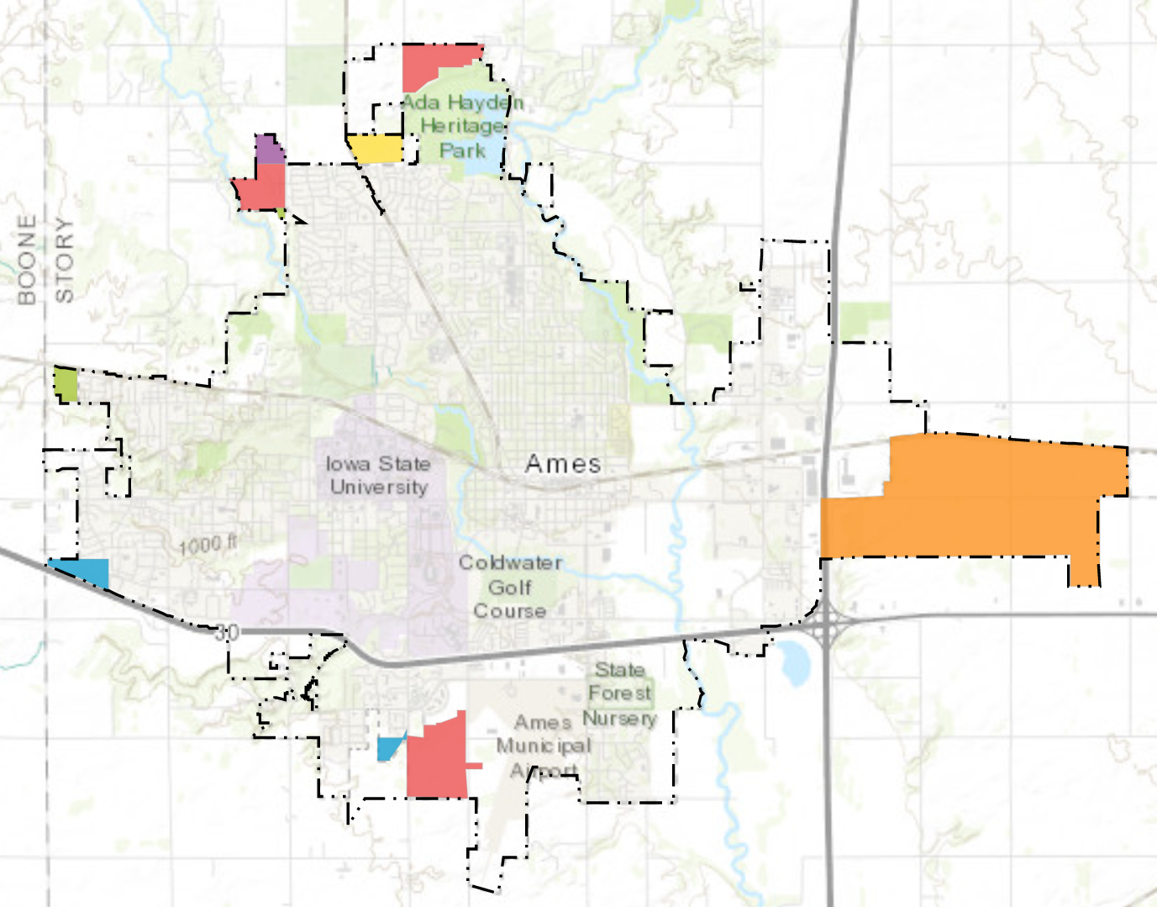
City of Ames
Population largely comprised of the Iowa State University population. University is also the largest employer.
The areas annexed by the city has been growing slowly over the years.
Source: City of Ames
Notes:
Colored areas are those added from 2013 to 2018.

Slide 4
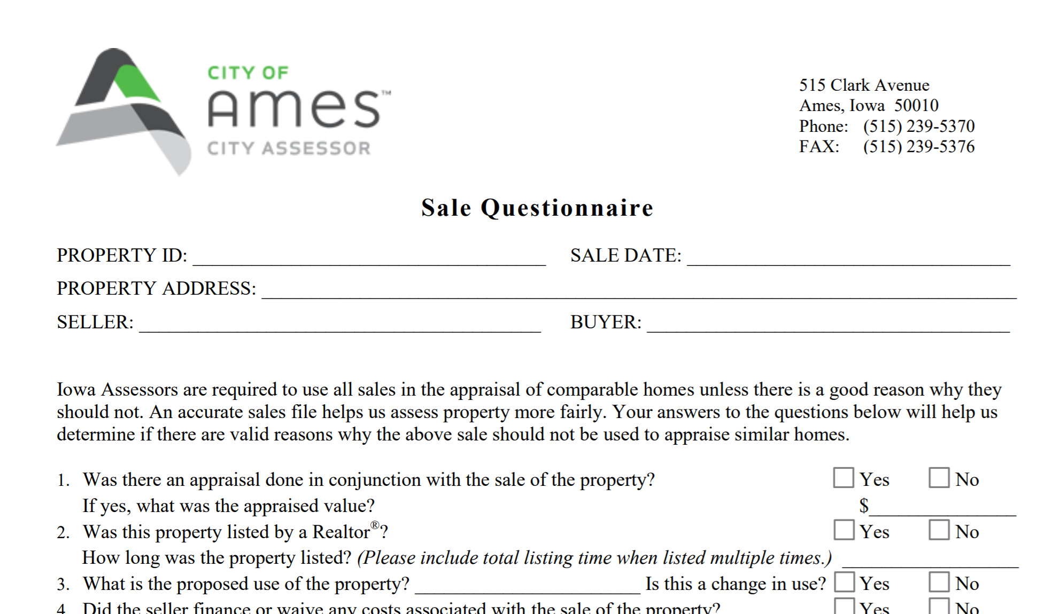
Data Source
Data from the Ames City Assessor
Collated from surveys filled in by home buyers
Obtained by Dean De Cock, of Truman State University
Accessed on Kaggle
Source: City of Ames

Slide 5
Data Cleaning
Ordinal
Numbers
E.g. Ex, Gd, TA, Fa, Po, NA
E.g. 5, 4, 3, 2, 1, 0
Missing Values
Impute 0 / ‘None’
House does not have this attribute
Outliers
Remove
Gr Liv Area more than 4000 Sq Ft but low Price (2 Outliers)
Nominal
One Hot Encoding
Convert categories to numbers using dummy variables

Slide 6
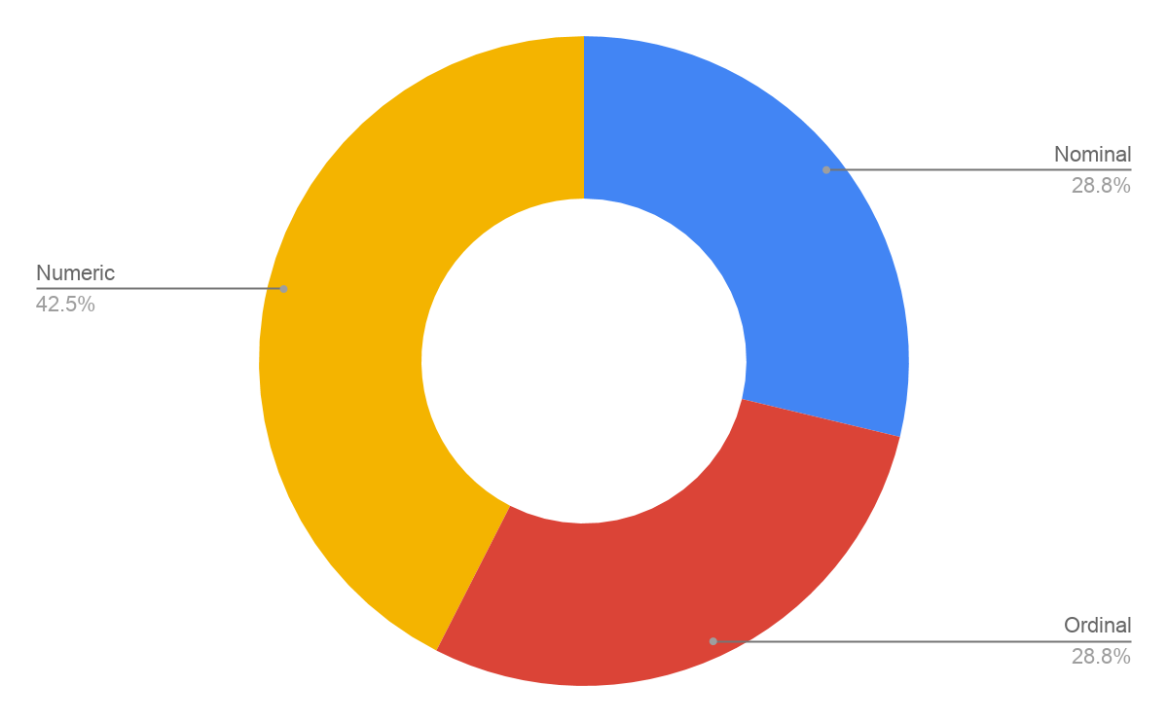
Numeric Variables
All Variables
Ordinal Variables
Nominal Variables
Notes:
The variables were segmented into 3 respective groups of numeric, ordinal and nominal variables for better and accurate representation of exploratory data analysis.

Slide 7
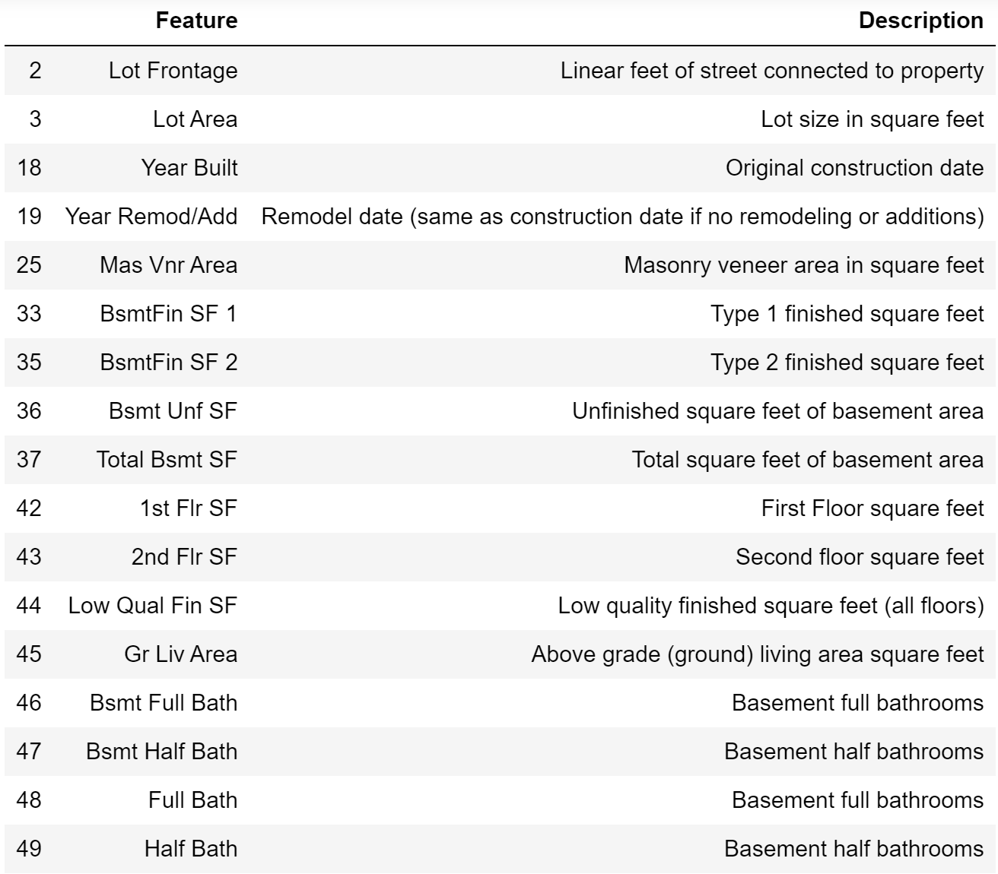
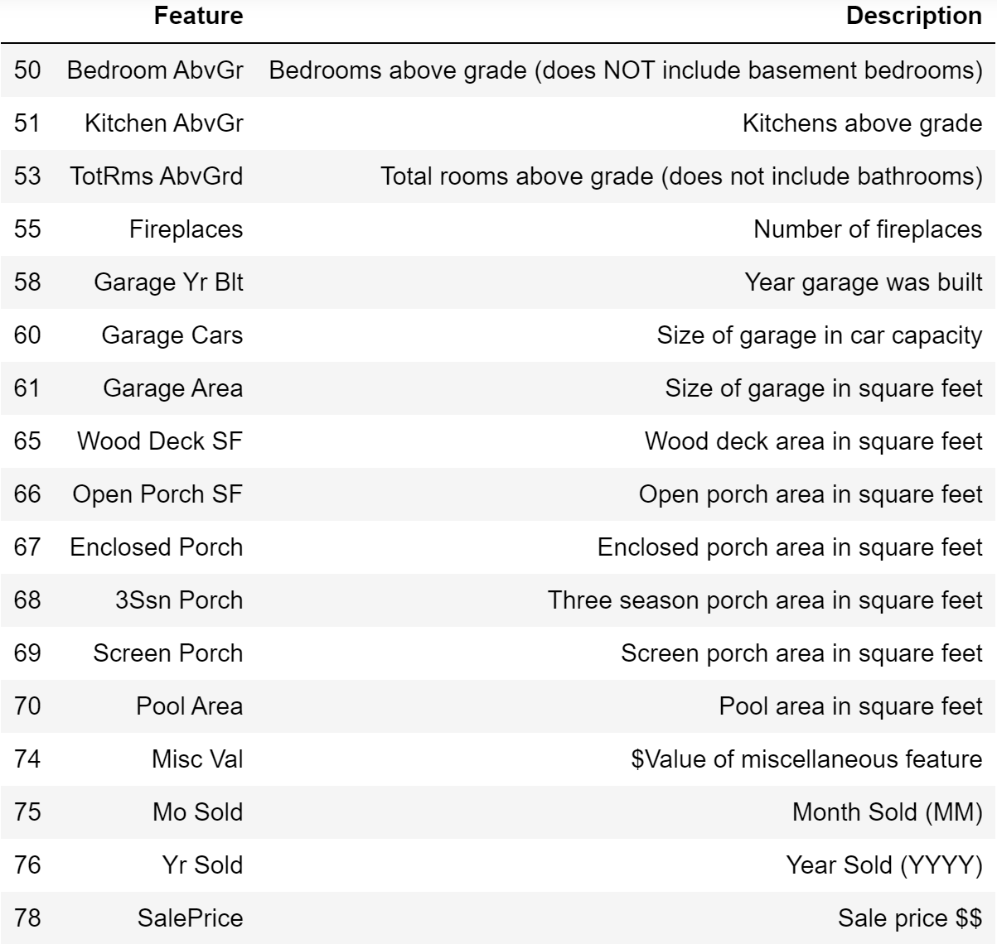
Numeric
34 Variables

Slide 8
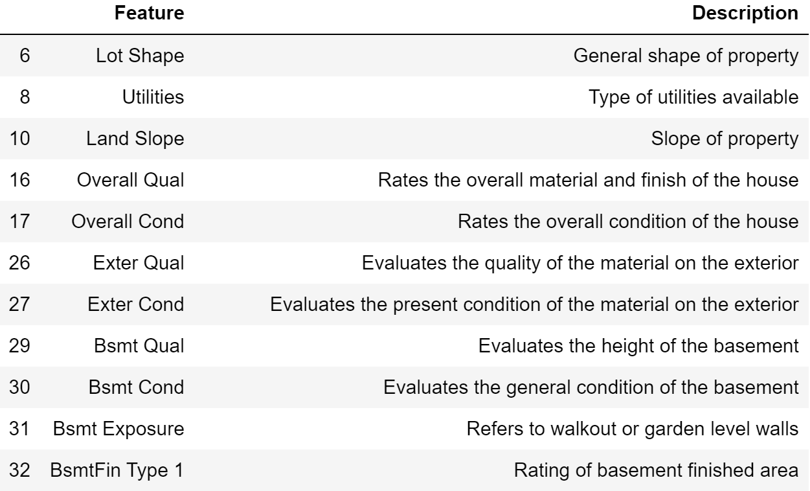
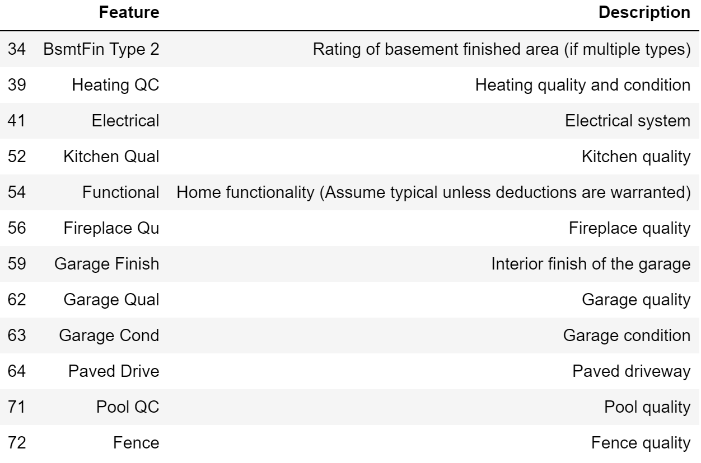
Ordinal
23 Variables

Slide 9
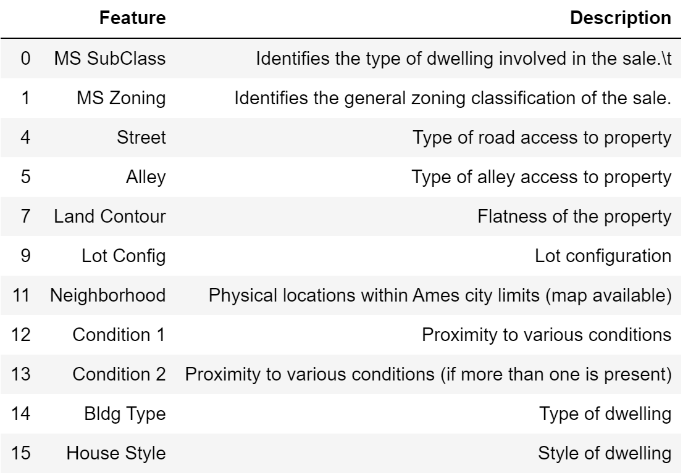
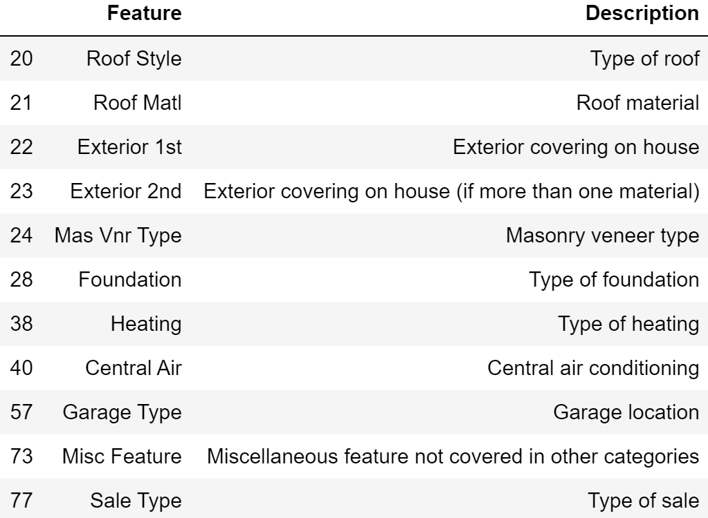
Nominal
22 Variables

Slide 10
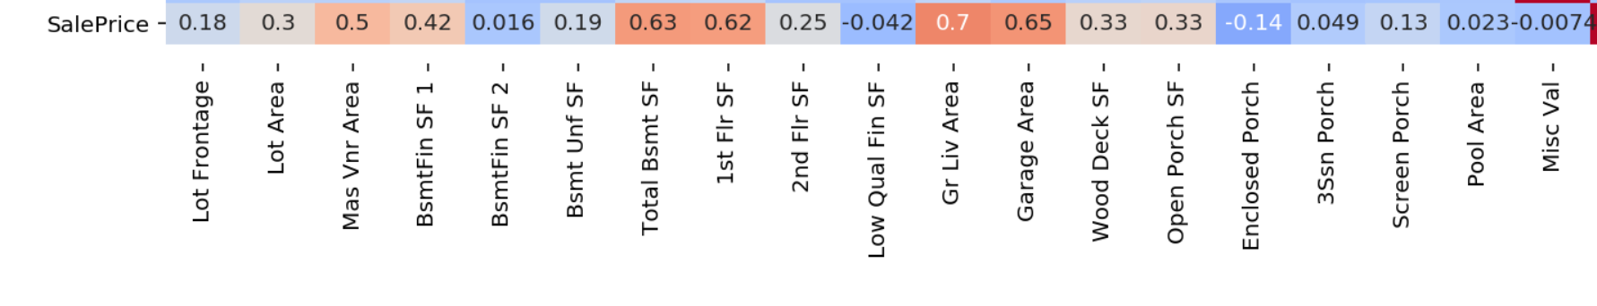
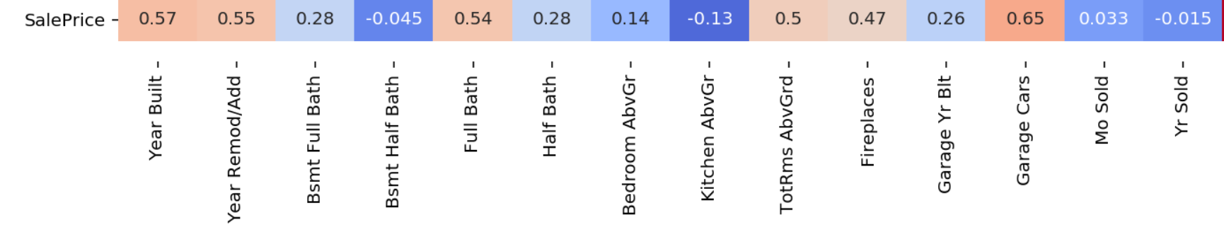
Correlation of Numerical Variables to Sale Price
Size matters!
Newness matters!
Notes:
According to statistical tests conduction on each variable, several variables are correlated with Sale Price. The strongest correlations are with variables that describe the size of the house, e.g. Living Area, 1st Flr SF, and the variables that describe the quality (e.g. Overall Quality)
Based on Pearson/Spearman’s correlation coefficient
Darker (esp red) = higher correlation

Slide 11
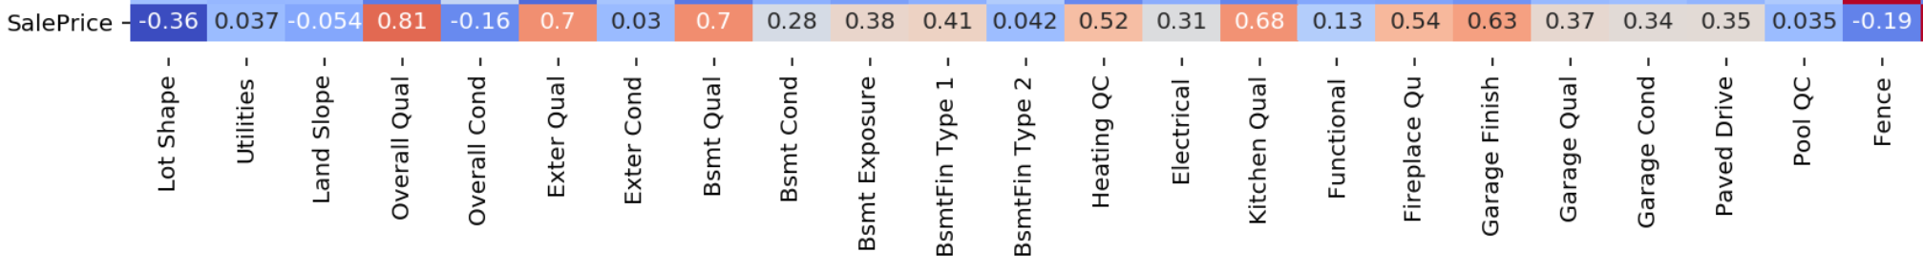
Correlation of Ordinal Variables to Sale Price
Quality matters!
Notes:
According to statistical tests conduction on each variable, several variables are correlated with Sale Price. The strongest correlations are with variables that describe the size of the house, e.g. Living Area, 1st Flr SF, and the variables that describe the quality (e.g. Overall Quality)
Based on Pearson/Spearman’s correlation coefficient
Darker (esp red) = higher correlation

Slide 12
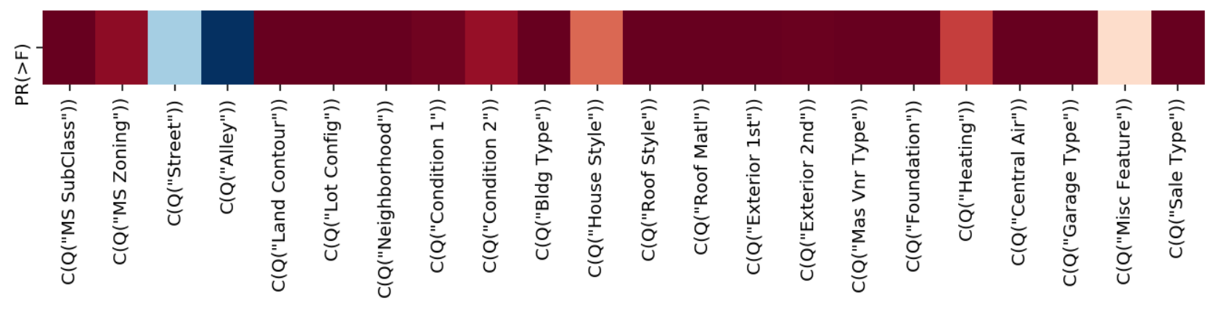
Nominal Variables Impacting Sale Price
16 variables with difference in mean Sale Price
Notes:
Dark red = reject null hypothese; i.e. not independent
Probability of independence based on N-factor ANOVA
Does not account for collinearity

Slide 13
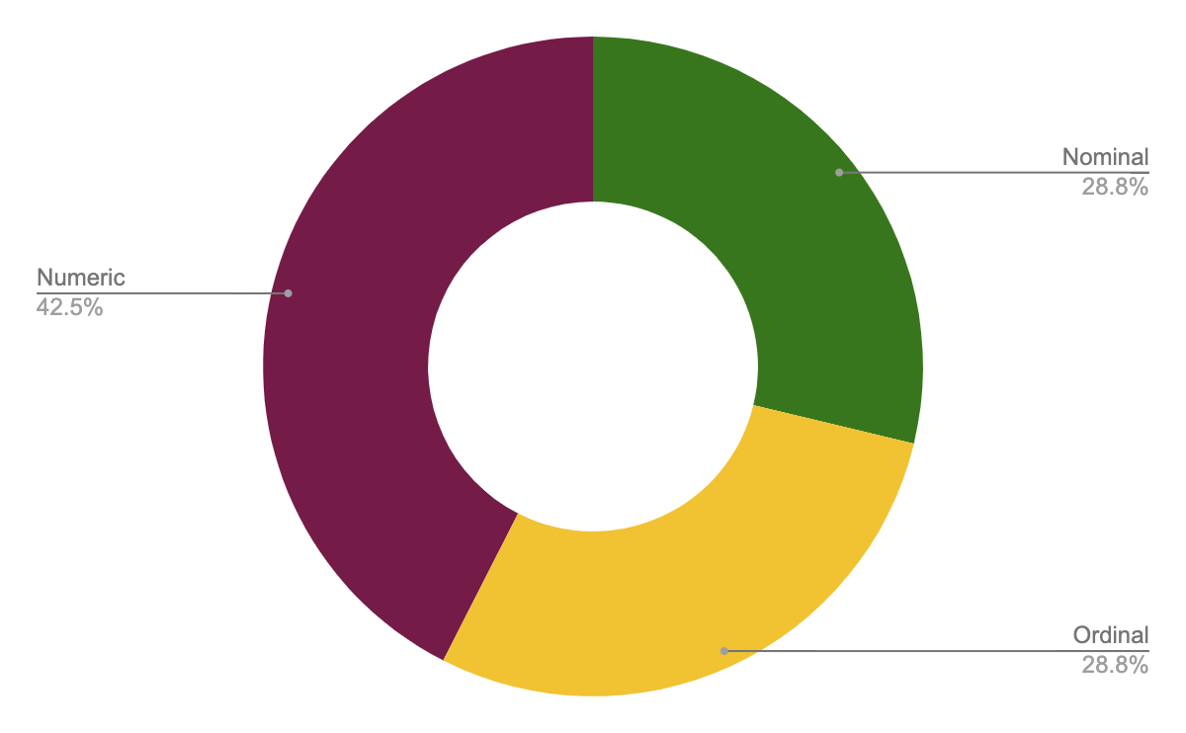
Notes:
Adding on to the correlation of the segmented variables of 3 respective groups of numeric, ordinal and nominal variables, we plotted different types of graphs for each group for better and accurate representation and comparison in the next part exploratory data analysis part.

Slide 14
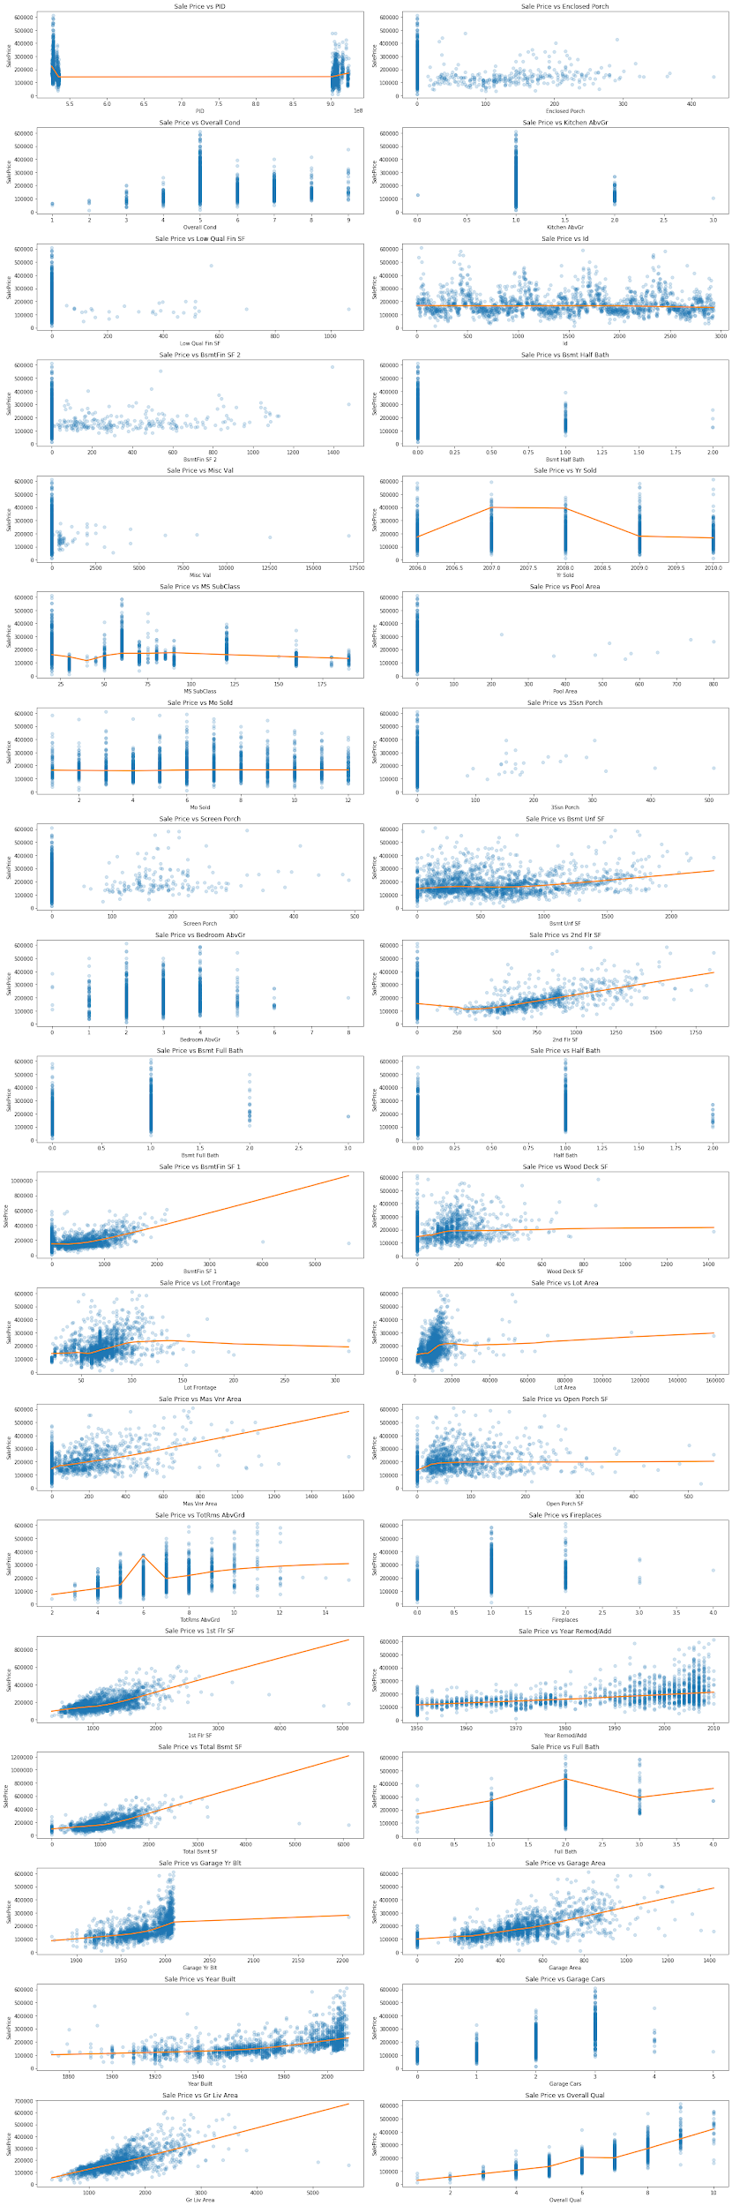
Numeric Variables
Notes:
We used scatter plots to observe and show relationships between each numeric variable and SalePrice. It doesn’t only report the values of individual data points, but also the patterns when the data are taken as a whole.
Showing the correlational relationships of each numeric variable and SalePrice

Slide 15
Numeric Variables
Notes:
You can see the high positive correlation between numeric variables and SalesPrice as well as

Slide 16
Numeric Variables

Slide 17
Numeric Variables

Slide 18
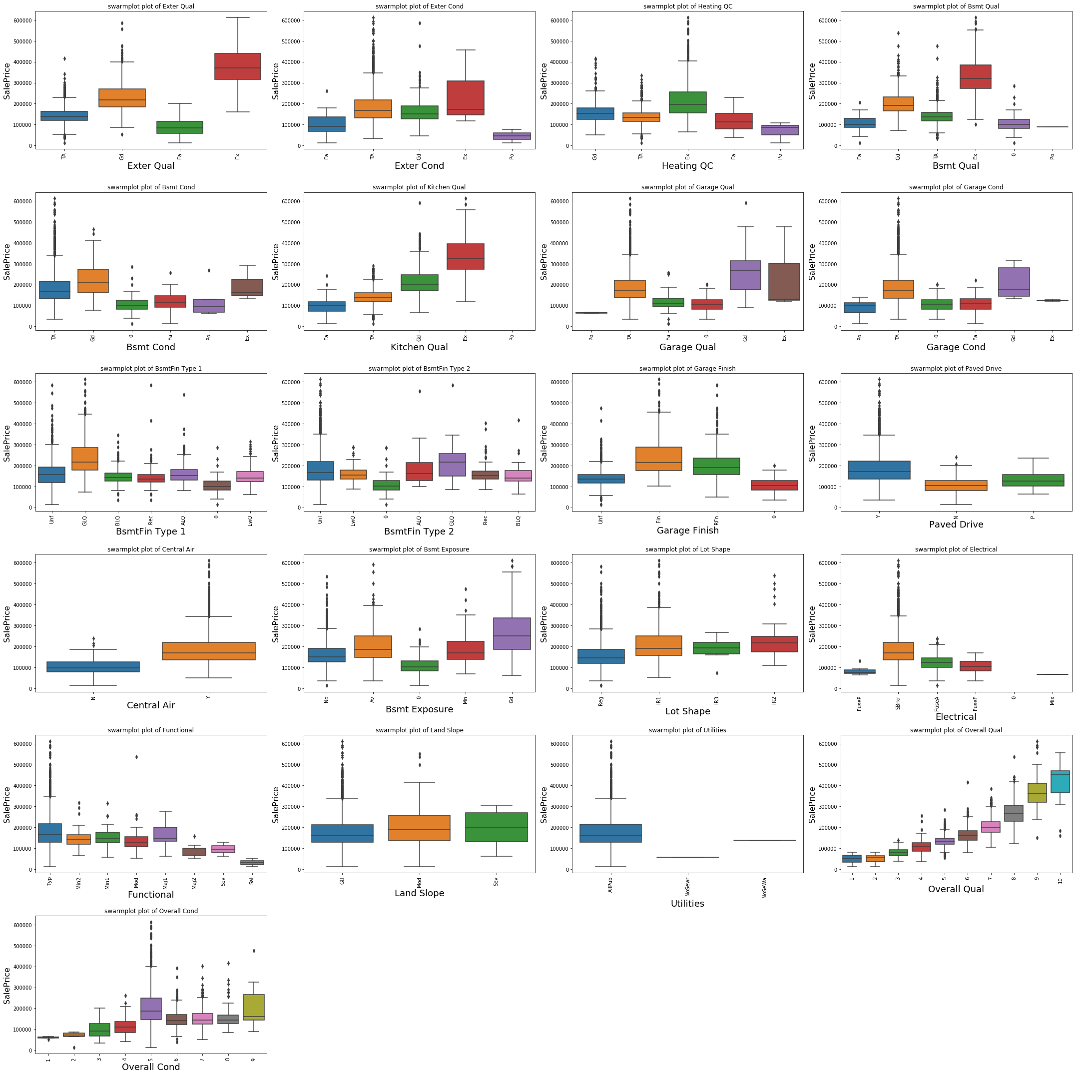
Ordinal Variables
Notes:
We plotted the variables in a box plots are useful in providing a good visual summary of the data as it shows the dispersion of the data set, outliers that maybe present and signs of skewness

Slide 19
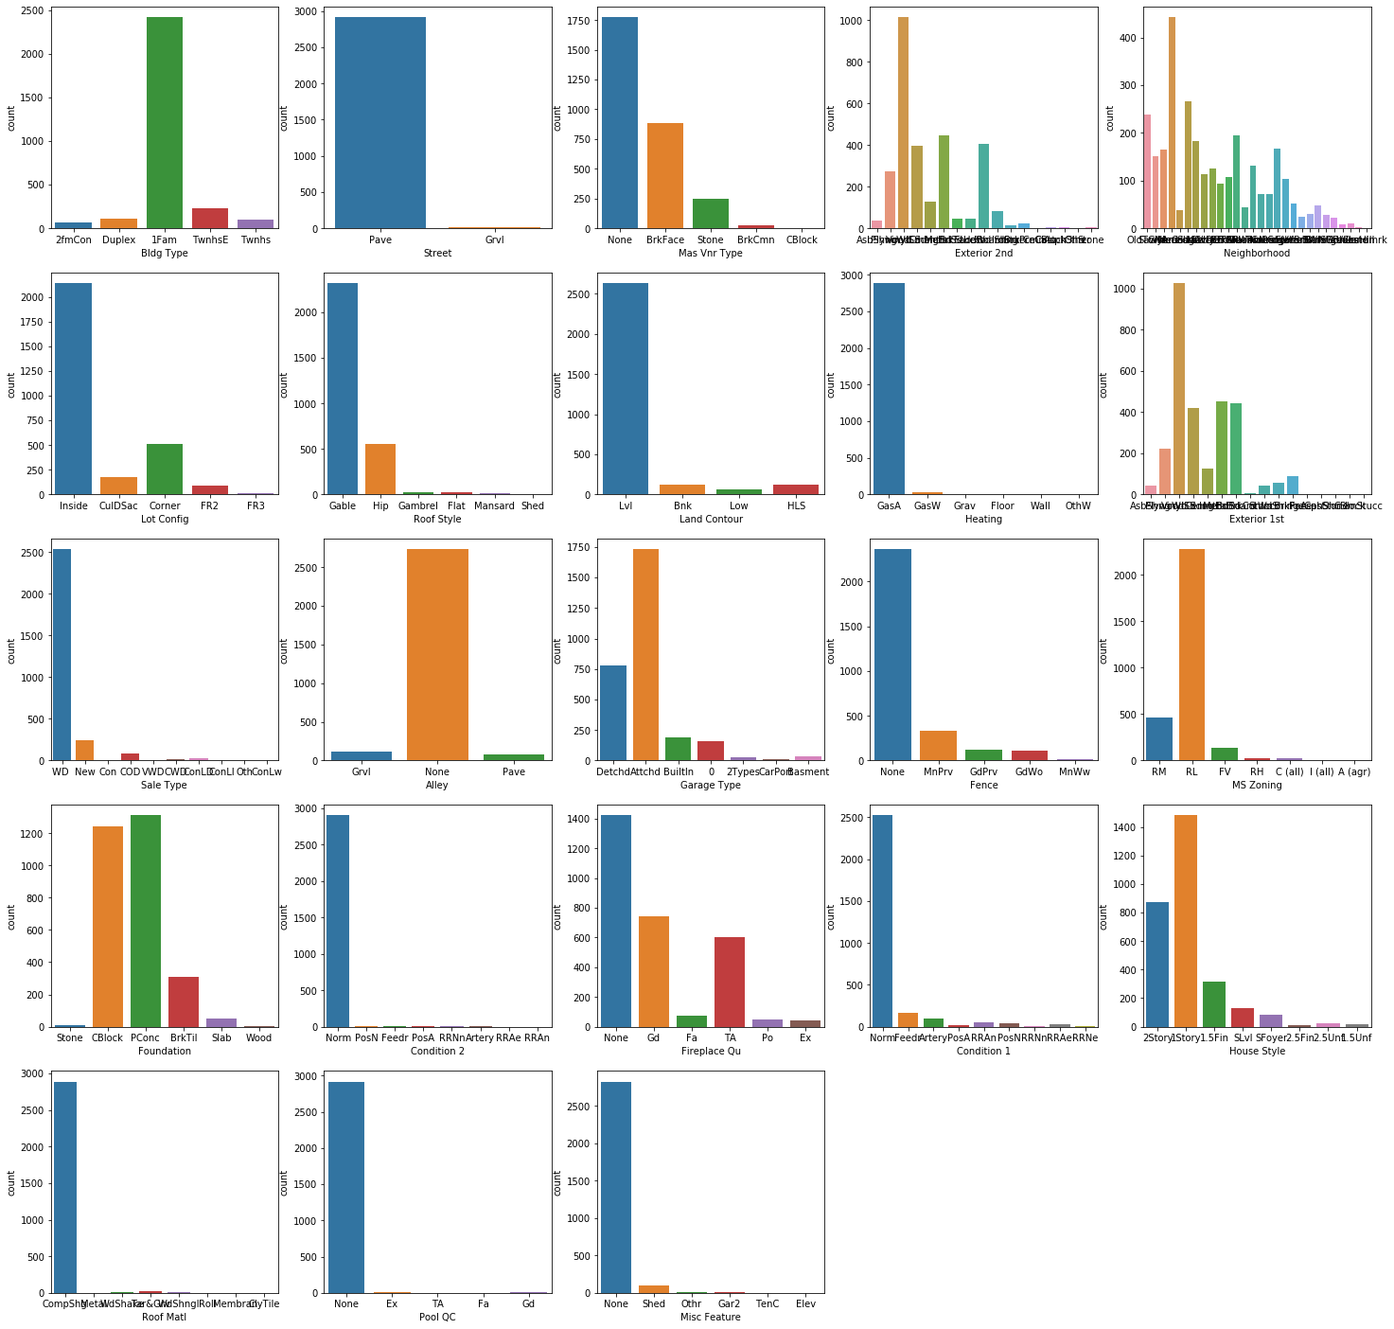
Nominal Variables
Notes:
We used a barplot to represent the nominal variables to show the count of each respective variable. Each entity of the categorical nominal variable is represented as a bar. The size of the bar represents its numeric value.

Slide 20
Feature Engineering
Feature Engineering was implemented step by step and the results were tested at each stage to ascertain if it was making the model more accurate
Steps taken:
Certain related features were combined. E.g Additional columns were added for total Baths & total Square foot
Polynomial feature columns were created for the variables with highest correlation to output
Recursive feature elimination was implemented to reduce the number of variables used in the model
Other techniques explored:
Chi2 to extract categorical features that were most related to the target. Target (continuous) was split into ordinal bins (for chi2 to work)
VIF to eliminate highly correlated numerical features

Slide 21
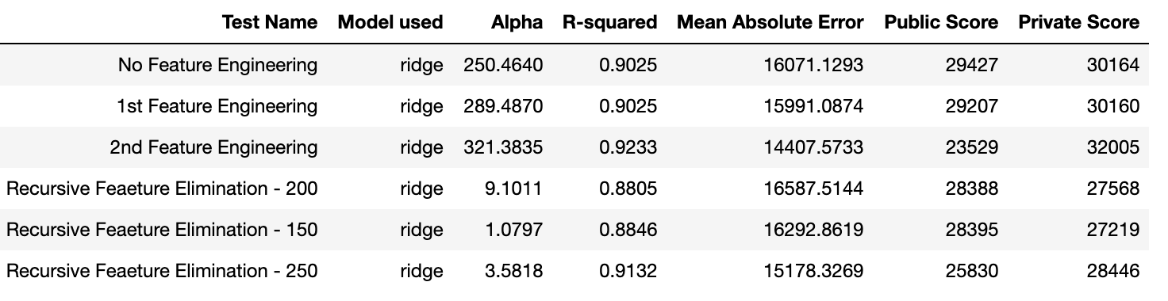
Feature Engineering Results
All iterations of our feature engineering was run through a function that compared Ridge, Lasso & Normal Linear regression models before choosing the one which had the best score & Metrics. Hyper Parameters were tuned using GridSearch. The results for the various iterations are as follows:

Slide 22
Conclusion
Best 10 coefficients/features:
1 | 33821.9651 | Neighborhood_NoRidge
2 | 31521.58977 | Roof Matl_WdShngl
3 | 29624.73447 | Neighborhood_StoneBr
4 | 23916.54094 | Garage Qual_Gd
5 | 22269.32372 | Total Bsmt SF
6 | 19251.15009 | Kitchen Qual_Ex
7 | 17242.86124 | Exter Qual_Ex
8 | 16726.19396 | Garage Type_BuiltIn
9 | 16588.55204 | Neighborhood_NridgHt
10 | 15368.51248 | Bsmt Exposure_Gd

Slide 23
Conclusion
Worst 10 coefficients/features:
1 | -14793.81473 | Functional_Sal
2 | -11655.56086 | Heating QC_Po
3 | -10951.82426 | MS Zoning_A (agr)
4 | -9196.783825 | Exter Qual_TA
5 | -8928.719741 | Heating_Grav
6 | -7958.539757 | Bsmt Unf SF
7 | -7812.518201 | Bsmt Qual_Gd
8 | -7775.999311 | Kitchen Qual_TA
9 | -7549.908939 | Neighborhood_Gilbert
10 | -7276.026174 | Neighborhood_OldTown

Slide 24

Mean SalePrice of Best 10 vs Worst 10 features
Neighborhood_NoRidge | $ 313,875
Roof Matl_WdShngl | $ 354,250
Neighborhood_StoneBr | $ 329,676
Garage Qual_Gd | $ 262,989
Total Bsmt SF (Large ) | $ 335,802
Kitchen Qual_Ex | $ 339,485
Exter Qual_Ex | $ 379,588
Garage Type_BuiltIn | $ 247,884
Neighborhood_NridgHt | $ 322,831
Bsmt Exposure_Gd | $ 272,549
Functional_Sal | $ 31,550
Heating QC_Po | $ 69,033
MS Zoning_A (agr) | $ 47,300
Exter Qual_TA | $ 142,840
Heating_Grav | $ 65,180
Bsmt Unf SF (Small ) | $ 142,153
Bsmt Qual_Gd | $ 201,858
Kitchen Qual_TA | $ 139,502
Neighborhood_Gilbert | $ 189,228
Neighborhood_OldTown | $ 125,276

Slide 25
Recommendation
To provide accurate house saleprices, focus on collecting data for these 14 features (consolidated from the 20 features)
1 | Neighborhood
2 | Roof Matl
3 | Garage Qual
4 | Total Bsmt SF
5 | Kitchen Qual
6 | Exter Qual
7 | Garage Type
8 | Bsmt Exposure
9 | Functional
10 | Heating QC
11 | MS Zoning
12 | Heating
13 | Bsmt Unf SF
14 | Bsmt Qual

Slide 26
Future work
Extra features we could include in future:
Schools, amenities, expressways, factories/employment centres, major towns within a certain radius
Vicinity to Iowa State University (largest employer)
Air quality (eg. NOx levels) in the region

